Slide 1
Data Science 100 Lecture 7: Modeling and Estimation
?
Slides by:
Joseph E. Gonzalez, jegonzal@berkeley.edu
2018 updates - Fernando Perez, fernando.perez@berkele.edu

Slide 2
Recap … so far we have covered
Data collection: Surveys, sampling, administrative data
Data cleaning and manipulation: Pandas, text & regexes.
Exploratory Data Analysis
Joining and grouping data
Structure, Granularity, Temporality, Faithfulness and Scope
Basic exploratory data visualization
Data Visualization:
Kinds of visualizations and the use of size, area, and color
Data transformations using Tukey Mosteller bulge diagram
An introduction to database systems and SQL

Slide 3
Today – Models & Estimation

Slide 4
What is a model?
Notes:
This is a deep question that touches the heart of science.
Ask audience questions:
how do they describe a model?

Slide 5
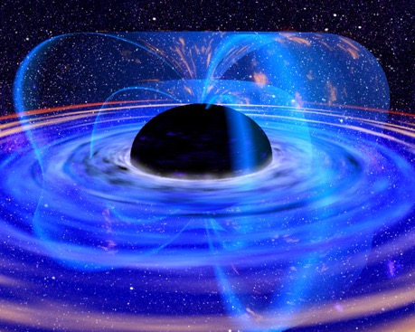
What is a model?
A model is an an idealized representation of a system
Atoms don’t actually work like this…
Proteins are far more complex
We haven’t really seen one of these.
Notes:
Are atoms like little solar systems?
Do proteins really have these colors?

Slide 6
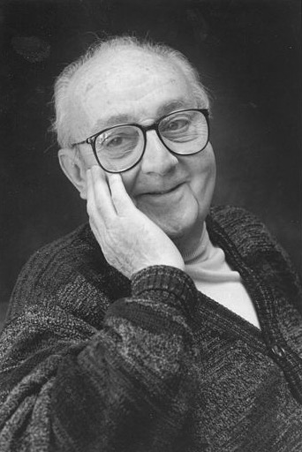
“Essentially, all models are wrong, but some are useful.”
George Box
Statistician
1919-2013
Notes:
1919-2013

Slide 7
Why do we build models?

Slide 8
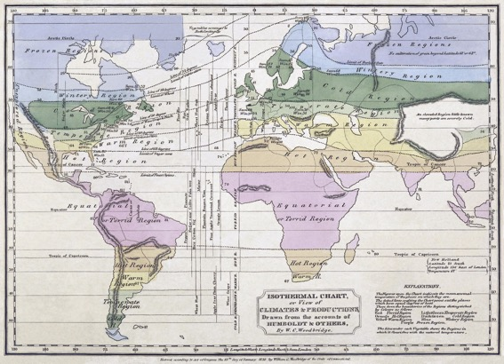


Why do we build models?
Models enable us to make accurate predictions

Slide 9
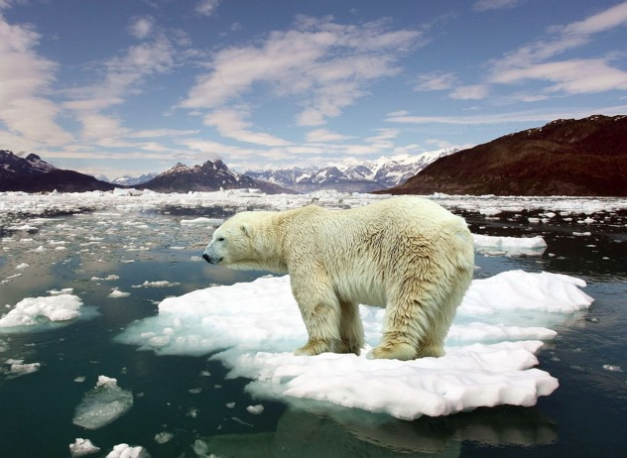
Why do we build models?
Models enable us to make accurate predictions
Provide insight into complex phenomena

Slide 10
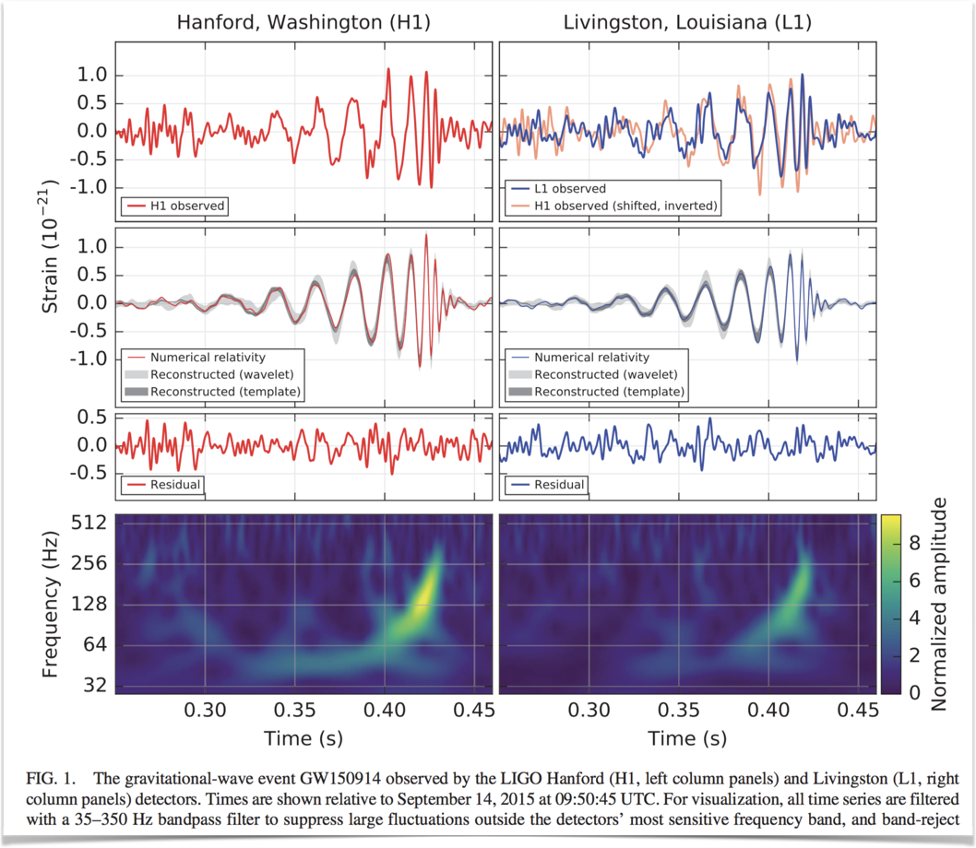
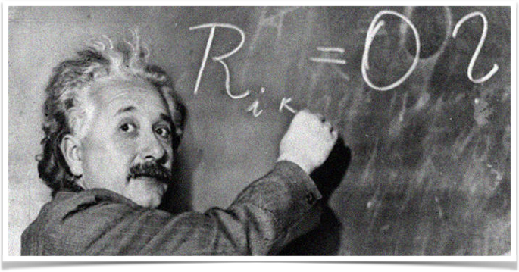
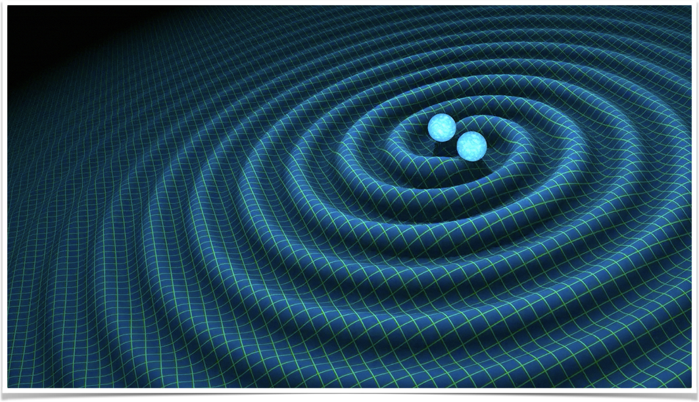
A few types of models: “physical” or “mechanistic”

Slide 11
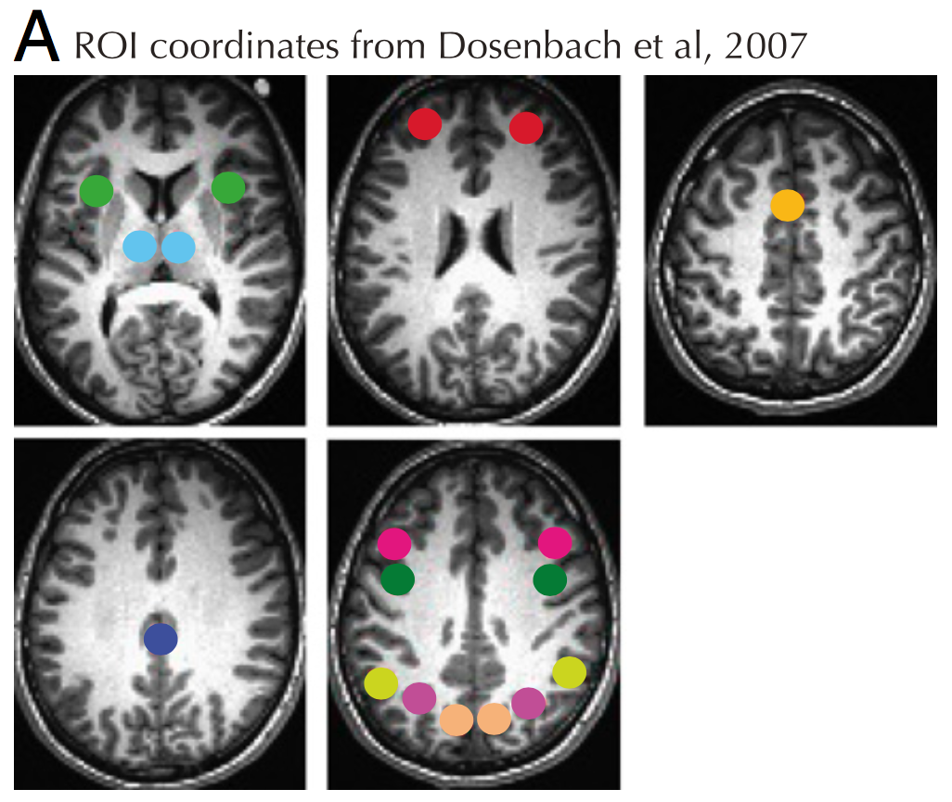
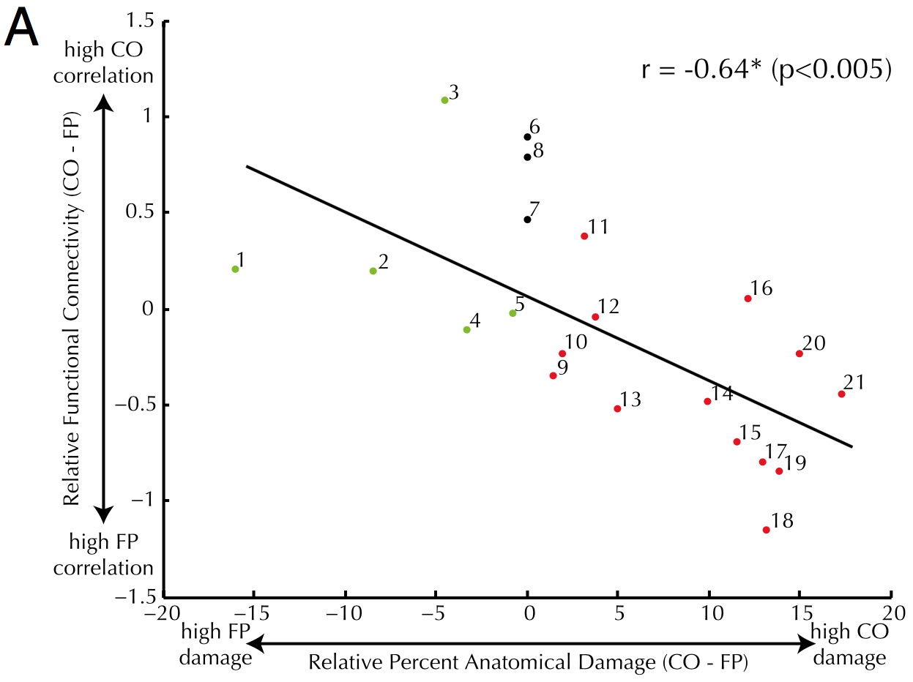
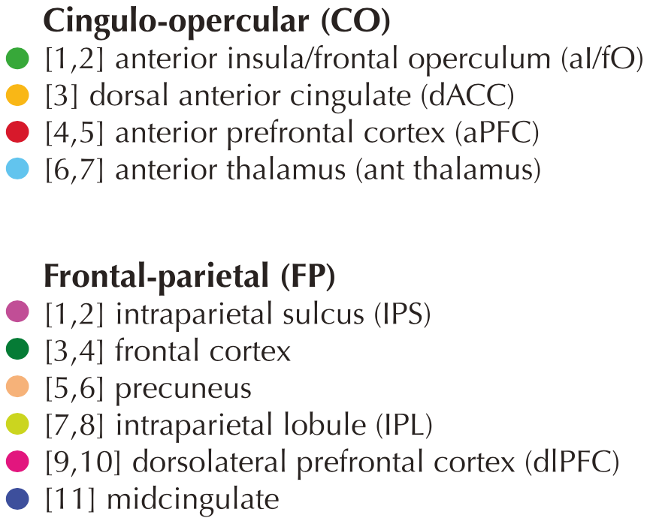
Models: Statistical correlations (A)
Nomura et al, PNAS 2010
Notes:
Simple linear/logistic regression
Underlying natural/causal mechanisms are assumed, though not understood.

Slide 12
Models: statistical correlations (B)
Massouh et al. IROS 2017
Notes:
Complex statistical models.
Expected to capture something about the real world (in this case) but mechanism not understood.
Can have excellent predictive accuracy.

Slide 13
Models: statistical correlations (C)
Pérez et al. CISE 2007
Notes:
May only capture a fleeting feature of the current state of the system.
The system itself may evolve because of the use of the model.
Not necessarily any underlying “truth” to be learned.

Slide 14
Models and the World
Data Generation Process: the real-world phenomena from which the data is collected
Example: everyday there are some number of clouds and it rains or doesn’t
We don’t’ know or can’t compute this, could be stochastic or adversarial
Model: a theory of the data generation process
Example: if there are more than X clouds then it will rain
How do we pick this model? EDA? Art?
May not reflect reality … “all models are wrong …”
Estimated Model: an instantiation of the model
Example: If there are more than 42 clouds then it will rain
How do we estimate it?
What makes the estimate “good”?

Slide 15
Example – Restaurant Tips
Follow along with the notebook …

Slide 16
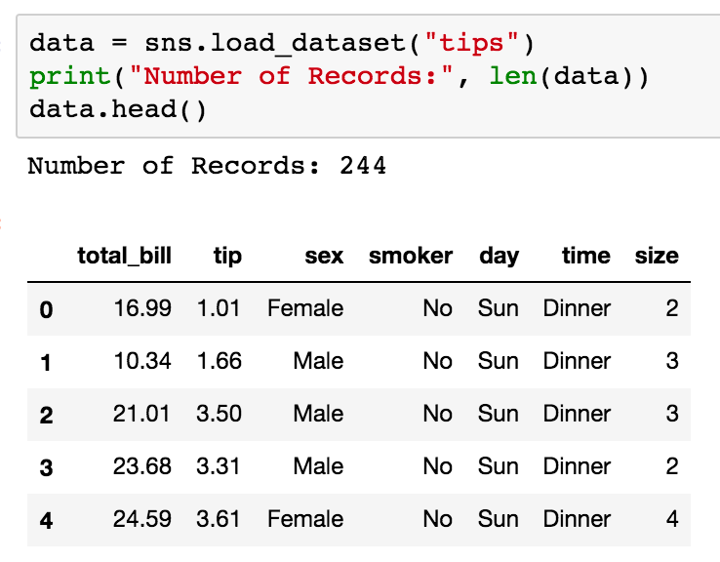
Step 1: Understanding the Data (EDA)
Collected by a single waiter over a month
Why?
Predict which tables will tip the highest
Understand relationship between tables and tips

Slide 17
Understanding the Tips
Observations:
Right skewed
Mode around $15
Mean around $20
No large bills
Observations:
Right skewed
Mean around 3
Possibly bimodal? → Explanations?
Large outliers → Explanations?
Notes:
Ask students for some explanations of this data.
What’s wrong with these plots?
But don’t spend too much time discussing them.

Slide 18
Derived Variable: Percent Tip
Natural representation of tips
Why? Tradition in US is to tip %
Issues in the plot?
Outliers
Explanation?
Small bills … bad data?
Transformations?
Remove outliers

Slide 19
Step 1: Define the Model
START SIMPLE!!
Notes:
* Simplest possible!!

Slide 20
Start with a Simple Model: Constant
* Means true parameter determined by universe
Rationale: There is a percent tip θ* that all customers pay
Correct?
No! We have different percentage tips in our data
Why? Maybe people make mistakes calculating their bills?
Useful?
Perhaps. A good estimate θ* could allow us to predict future tips …
The parameter θ* is determined by the universe
we generally don’t get to see θ* …
we will need to develop a procedure to estimate θ* from the data

Slide 21
How do we estimate the parameter θ*
Guess a number using prior knowledge: 15%
Use the data! How?
Estimate the value θ* as:
the percent tip from a randomly selected receipt
the mode of the distribution observed
the mean of the percent tips observed
the median of the percent tips observed
Which is the best? How do I define best?
Depends on our goals …

Slide 22
Defining an the Objective (Goal)
Ideal Goal: estimate a value for θ* such that the model makes good predictions about the future.
Great goal! Problem?
We don’t know the future. How will we know if our estimate is good?
There is hope! … we will return to this goal … in the future ☺
Simpler Goal: estimate a value for θ* such that the model “fits” the data
What does it mean to “fit” the data?
We can define a loss function that measures the error in our model on the data
Notes:
* We’ll see how the choice of loss function impacts our value of θ*.

Slide 23
Step 2: Define the Loss
“Take the Loss”

Slide 24
Loss Functions
Loss function: a function that characterizes the cost, error, or loss resulting from a particular choice of model or model parameters.
Many definitions of loss functions and the choice of loss function affects the accuracy and computational cost of estimation.
The choice of loss function depends on the estimation task
quantitative (e.g., tip) or qualitative variable (e.g., political affiliation)
Do we care about the outliers?
Are all errors equally costly? (e.g., false negative on cancer test)
Notes:
Different loss functions behave differently w/regard to outliers.
“Loss” function: because it quantifies how much our model loses compared to a perfect/ideal fit.

Slide 25
Squared Loss
Widely used loss!
The “error” in our prediction
The predicted value
An observed data point
Also known as the the L² loss (pronounced “el two”)
Reasonable?
θ = y ➔ good prediction ➔ good fit ➔ no loss!
θ far from y ➔ bad prediction ➔ bad fit ➔ lots of loss!

Slide 26
Absolute Loss
It sounds worse than it is …
Absolute value
Also known as the the L¹ loss (pronounced “el one”)
Reasonable?
θ = y ➔ good prediction ➔ good fit ➔ no loss!
θ far from y ➔ bad prediction ➔ bad fit ➔ some loss
Notes:
Name one key difference between this plot and the previous one.
Vertical scale: L2 is much more sensitive.
Sharp corner: non-differentiable.
Curvature: L2 increasingly penalizes outliers.

Slide 27
Can you think of another Loss Function?

Slide 28
Huber Loss
Parameter 𝛼 that we need to choose.
Reasonable?
θ = y ➔ good prediction ➔ good fit ➔ no loss!
θ far from y ➔ bad prediction ➔ bad fit ➔ some loss
A hybrid of the L2 and L1 losses…
Notes:
Named after Peter Huber, a swiss staticitian

Slide 29
The Huber loss function, interactively

Slide 30
Comparing the Loss Functions
All functions are zero when θ = y
Different penalties for being far from observations
Smooth vs. not smooth
Which is the best?
Let’s find out
Extend beyond single observation?

Slide 31
Average Loss
A natural way to define the loss on our entire dataset is to compute the average of the loss on each record.
In some cases we might take a weighted average (when?)
Some records might be more important or reliable
What does the average loss look like?
The set of n data points

Slide 32
Double Jeopardy
Name that Loss!

Slide 33
Name that loss
(a)
(b)
(c)
Squared Loss

Slide 34
Name that loss
Squared Loss
Absolute Loss
Huber Loss
(a)
(b)
(c)

Slide 35
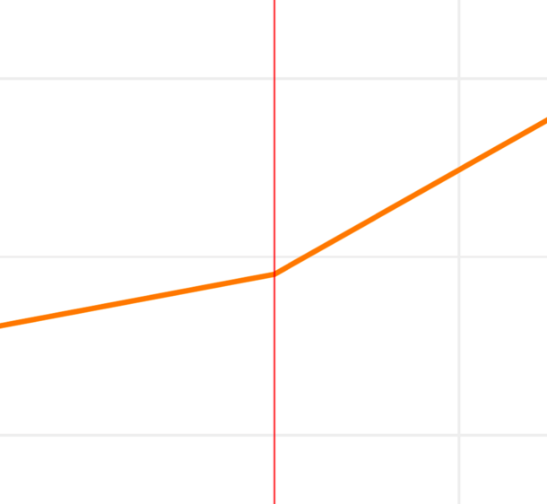
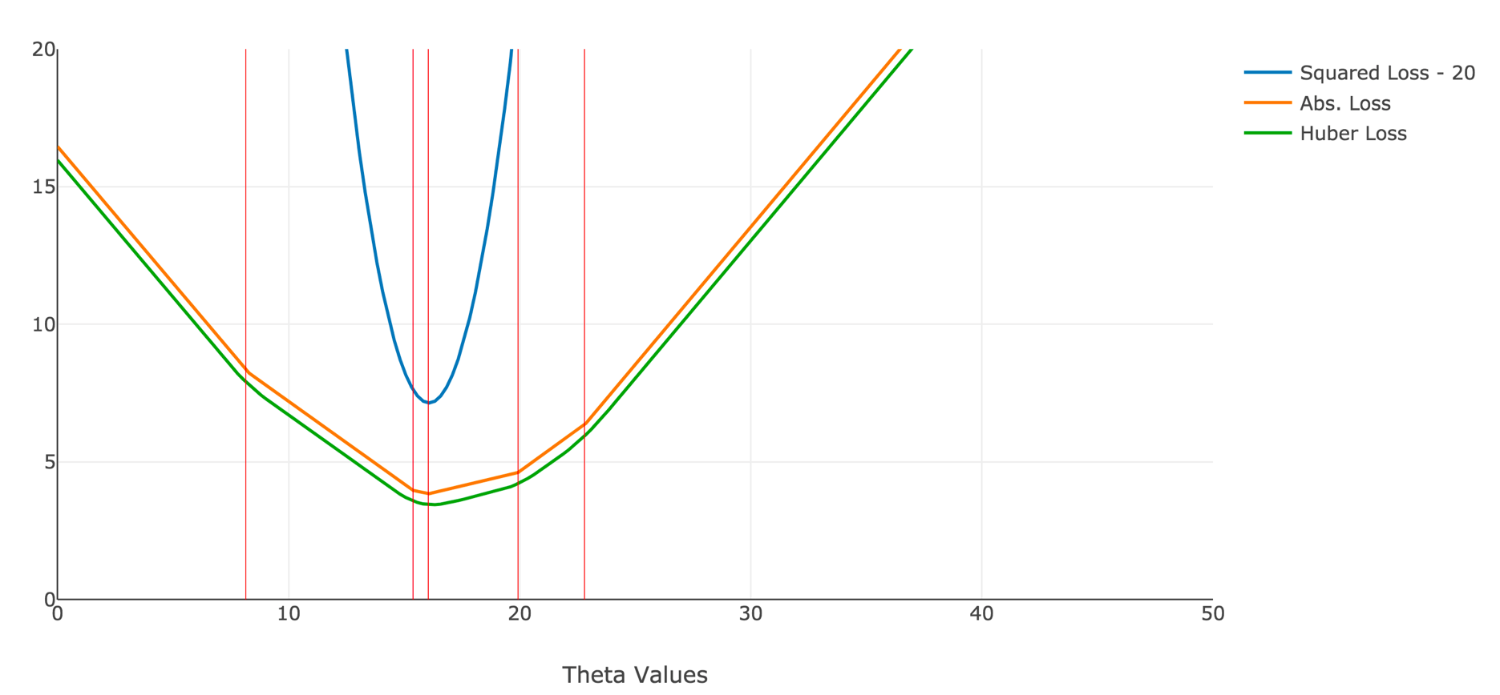
Difference between Huber and L1
Zoomed in with only 5 data points sampled at random
Corner
Notes:
Do they all have the same minimum?
If one is shifted, which one is and in which direction?

Slide 36
Absolute and Huber Loss have nearly identical
Values
→
← Squared Loss is slightly to the right
Different Minimizers
15.6
16.0

Slide 37
Sensitivity to Outliers
34% of loss due to a single point
Small fraction of loss on outliers…

Slide 38
Recap on Loss Functions
Loss functions: a mechanism to measure how well a particular instance of a model fits a given dataset
Squared Loss: sensitive to outliers but a smooth function
Absolute Loss: less sensitive to outliers but not smooth
Huber Loss: less sensitive to outliers and smooth but has an extra parameter to deal with
Why is smoothness an issue → Optimization! …

Slide 39
Summary of Model Estimation (so far…)
Define the Model: simplified representation of the world
Use domain knowledge but … keep it simple!
Introduce parameters for the unknown quantities
Define the Loss Function: measures how well a particular instance of the model “fits” the data
We introduced L², L¹, and Huber losses for each record
Take the average loss over the entire dataset
Minimize the Loss Function: find the parameter values that minimize the loss on the data
So far we have done this graphically
Now we will minimize the loss analytically

Slide 40
Step 3: Minimize the Loss

Slide 41
A Brief Review of Calculus

Slide 42
Minimizing a Function
Suppose we want to minimize:
Solve for derivative = 0:
Procedure:
take derivative
Set equal to zero
Solve for parameters

Slide 43
Quick Review of the Chain Rule
How do I compute the derivative of composed functions?
Derivative of f evaluated at g(θ)
Derivative of g(θ)
Bonus material (not covered in lecture) but useful for studying

Slide 44
Using the Chain Rule
First application of chain rule
Derivative of exponent
Substituting u
Second application of the chain rule
Derivative of sine function
Computing the remaining derivative
Bonus material (not covered in lecture) but useful for studying

Slide 45
All of the above functions have zero derivatives at θ = 3
➔ is θ=3 minimizer for all the above functions?
No!
Need to check second derivative is positive…

Slide 46
at θ = 3
Generally we are interested in convex functions with respect to the parameters θ.

Slide 47
Convex sets and polygons
No line segment between any two points on the boundary ever leaves the polygon.
Equivalently, all angles are ≤ 180º.
The interior is a convex set.

Slide 48
Non-Convex sets and polygons
There is at least one line segment between two points on the boundary that leaves the set.

Slide 49
Formal Definition of Convex Functions
Epigraph
Epigraph
All possible orange lines are:
always in epigraph or on black line
always above or equal to black line
Convex
Nonconvex
A function f is convex if and only if:
Notes:
Work the algebra at home and convince yourself that the formal definition is equivalent to the one above for sets, when applied to the epigraph.

Slide 50
http://bit.ly/ds100-sp18-cvx
Convex or Not Convex
Curve 1
Curve 2
Curve 3
Curve 4

Slide 51
Are our previous loss functions convex?
Yes!
Average Loss?
Yes!
(Sum of convex functions is convex)

Slide 52
Is a Gaussian convex?

Slide 53
Sum of Convex Functions is Convex
In class professor Gonzalez was asked: “Are you sure that the sum of convex functions is convex?”
The answer is yes! Always!
Professor Gonzalez should have had a proof ready! ☹ It’s Easy!
Proposed counter examples … (not entirely obvious)
Bonus material (not covered in lecture) but useful for studying

Slide 54
Formal Proof
Suppose you have two convex functions f and g:
We would like to show:
Where:
Bonus material (not covered in lecture) but useful for studying

Slide 55
Formal Proof
Suppose you have two convex functions:
We would like to show:
Where:
Starting on the left side
Substituting definition of h:
Re-arranging terms:
Convexity in f
Convexity in g
Definition of h
Bonus material (not covered in lecture) but useful for studying

Slide 56
Minimizing the Average Squared Loss

Slide 57
Minimizing the Average Squared Loss
Take the derivative

Slide 58
Minimizing the Average Squared Loss
Take the derivative
Set the derivative equal to zero

Slide 59
Minimizing the Average Squared Loss
Take the derivative
Set the derivative equal to zero
Solve for parameters
Hat
(Estimator)

Slide 60
Minimizing the Average Squared Loss
Hat
(Estimator)
Mean
(Average)!
The estimate for percent tip that minimizes the squared loss is the mean (average) of the percent tips
We guessed that already!

Slide 61
Minimizing the Average Absolute Loss
Take the derivative
How?
Constant Slope
Down
Constant Slope
Up
What is sign(0) ?

Slide 62
Minimizing the Average Absolute Loss
Take the derivative
How?
Constant Slope
Down
Constant Slope
Up
Derivative at the corner?
What is the sign of 0?
Convention:

Slide 63
Minimizing the Average Absolute Loss
Take the derivative
Set derivative to zero and solve for parameters

Slide 64
Minimizing the Average Absolute Loss
Take the derivative
Set derivative to zero and solve for parameters
Median!
2
θ
2
Percent Tips in sorted order
y₁
y₂
y₃
y₄
y₅
2
θ
?
2
Percent Tips in sorted order
y₁
y₂
y₃
y₄
Notes:
Trick question: what’s the estimator for theta in the second line?
We can choose any value in the [y2, y3] range.

Slide 65
Absolute Loss Even and Odd Data
Even Points
Odd Points
Many optimal values
Loss
Loss
θ
θ
θ
Pick one?
The median minimizes the absolute loss → Robust!
not sensitive to outliers

Slide 66
Calculus for Loss Minimization
General Procedure:
Verify that function is convex (we often will assume this…)
Compute the derivative
Set derivative equal to zero and solve for the parameters
Using this procedure we discovered:

Slide 67
Minimizing the Average Huber Loss
Take the derivative of the average Huber Loss

Slide 68
Minimizing the Average Huber Loss
Take the derivative of the average Huber Loss

Slide 69
Minimizing the Average Huber Loss
Take the derivative of the average Huber Loss

Slide 70
Minimizing the Average Huber Loss
Take the derivative of the average Huber Loss

Slide 71
Minimizing the Average Huber Loss
Take the derivative of the average Huber Loss
Set derivative equal to zero:
Solution?
No simple analytic solution …
We can still plot the derivative

Slide 72
Visualizing the Derivative of the Huber Loss
Alpha = 10
Large 𝜶 ➔ unique optimum like squared loss

Slide 73
Visualizing the Derivative of the Huber Loss
Alpha = 1
Alpha = 10
Many optimal values
Loss
θ
θ
θ
Derivative is continuous
Small 𝜶 ➔many optima
Large 𝜶 ➔ unique optimum like squared loss

Slide 74
Numerical Optimization

Slide 75
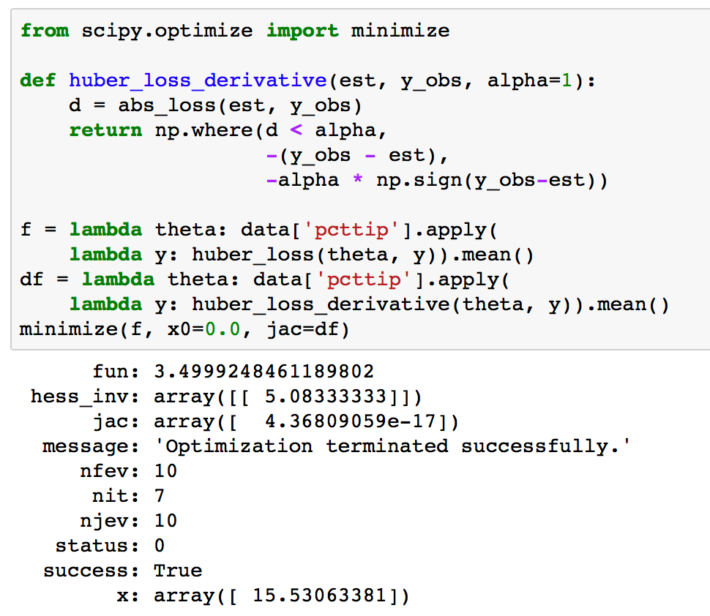
Minimizing the Huber Loss Numerically
Often we will use numerical optimization methods
The following are helpful properties when using numerical optimization methods:
convex loss function
smooth loss function
analytic derivative

Slide 76
Summary of Model Estimation
Define the Model: simplified representation of the world
Use domain knowledge but … keep it simple!
Introduce parameters for the unknown quantities
Define the Loss Function: measures how well a particular instance of the model “fits” the data
We introduced L², L¹, and Huber losses for each record
Take the average loss over the entire dataset
Minimize the Loss Function: find the parameter values that minimize the loss on the data
We did this graphically
Minimize the loss analytically using calculus
Minimize the loss numerically

Slide 77
Improving the Model

Slide 78
Going beyond the simple model
How could we improve upon this model?
Things to consider when improving the model
Related factors to the quantity of interest
Examples: quality of service, table size, time of day, total bill
Do we have data for these factors?
The form of the relationship to the quantity of interest
Linear relationships, step functions, etc …
Goals for improving the model
Improve prediction accuracy → more complex models
Provide understanding → simpler models
Is my model “identifiable” (is it possible to estimate the parameters?)
percent tip = θ₁* + θ₂* ← many identical parameterizations

Slide 79
Rationale:
Larger bills result in larger tips and people tend to to be more careful or stingy on big tips.
Parameter Interpretation:
θ₁: Base tip percentage
θ₂: Reduction/increase in tip for an increase in total bill.
Often visualization can guide in the model design process.

Slide 80
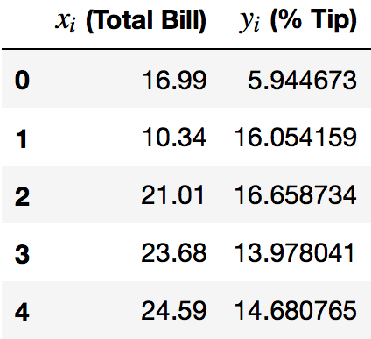
Estimating the model parameters:
Write the loss (e.g., average squared loss)
% Tip
Total Bill
n

Slide 81
Estimating the model parameters:
Write the loss (e.g., average squared loss)
Take the derivative(s):

Slide 82
Estimating the model parameters:
Write the loss (e.g., average squared loss)
Take the derivative(s):

Slide 83
Estimating the model parameters:
Write the loss (e.g., average squared loss)
Take the derivative(s):
Set derivatives equal to zero and solve for parameters

Slide 84
Solving for θ₁
Breaking apart the sum
0
Rearranging
Terms

Slide 85
Solving for θ₁
Divide by n
Define the average of x and y:

Slide 86
Solving for θ₂
Scratch
Distributing the x_{i} term
Breaking apart the sum

Slide 87
Solving for θ₂
Distributing the x_{i} term
Breaking apart the sum
Scratch
0
Rearranging
Terms
Divide by n

Slide 88
Solving for θ₂
Scratch

Slide 89
System of Linear Equations
Substituting θ₁ and solving for θ₂
solving for θ₂
Algebra…
Notes:
The last expression requires extra algebra stored in the slides.
It looks more complex, but it has a useful interpretation:
- theta_2 is the ratio cov(x,y)/var(x)
- with theta_1, we see that y_mean = theta_1 + theta_2*x_mean.

Slide 90
Denominator Derivation
Completing the squares:
Skipped in Class

Slide 91
Numerator Derivation
Completing the squares:
Skipped in Class

Slide 92
Summary so far …
Step 1: Define the model with unknown parameters
Step 2: Write the loss (we selected an average squared loss)
Step3: Minimize the loss
Analytically (using calculus)
Numerically (using optimization algorithms)

Slide 93
Summary so far …
Step 1: Define the model with unknown parameters
Step 2: Write the loss (we selected an average squared loss)
Step3: Minimize the loss
Analytically (using calculus)
Numerically (using optimization algorithms)

Slide 94
Set derivatives equal to zero and solve for parameter values
Is this a local minimum?

Slide 95
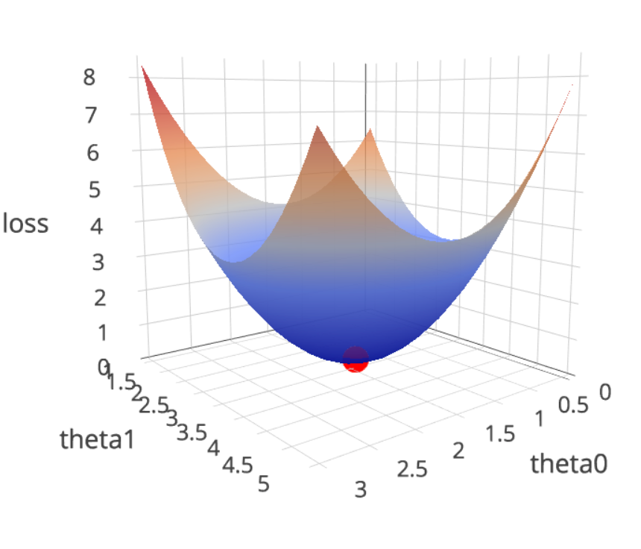
Visualizing the Higher Dimensional Loss
What does the loss look like?
Go to notebook …

Slide 96
“Improving” the Model (more…)

Slide 97
Rational:
Each term encodes a potential factor that could affect the percentage tip.
Possible Parameter Interpretation:
θ₁: base tip percentage paid by female non-smokers without accounting for table size.
θ₂: tip change associated with male patrons ...
Maybe difficult to estimate … what if all smokers are male?
Difficult to Plot
Go to Notebook

Slide 98
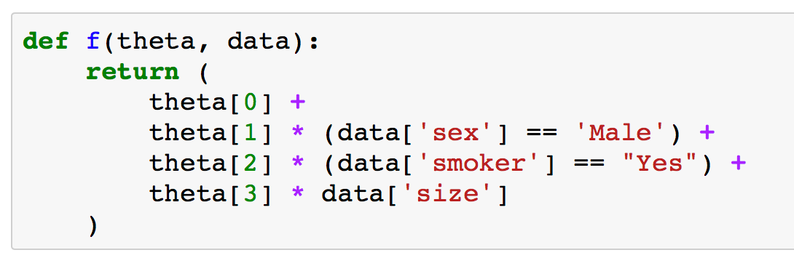
Define the model
Use python to define the function

Slide 99
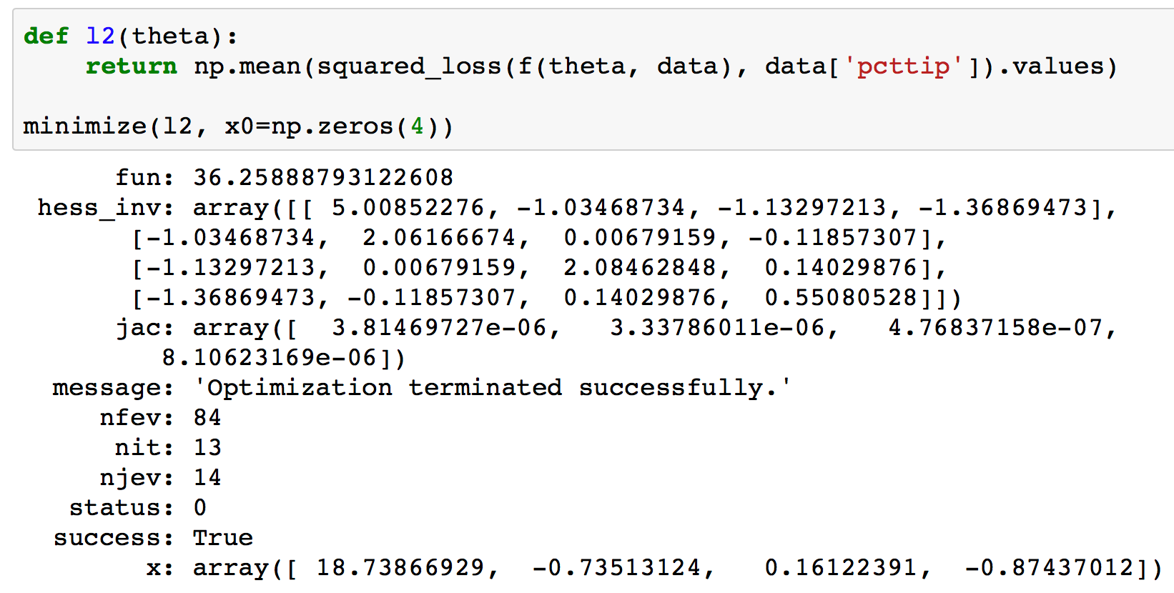
Define and Minimize the Loss

Slide 100
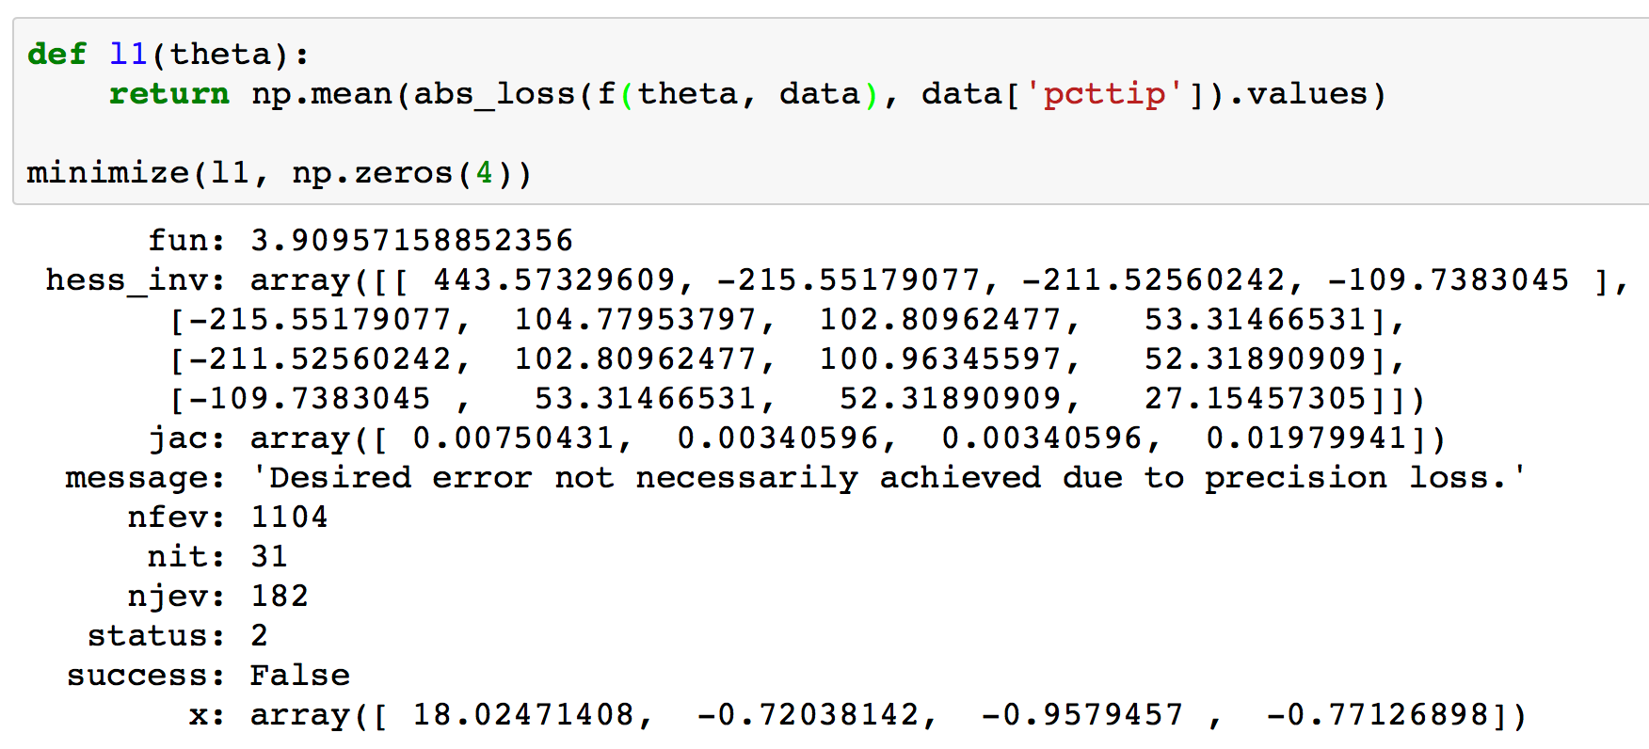
Define and Minimize the Loss
Why?
Function is not smooth → Difficult to optimize

Slide 101
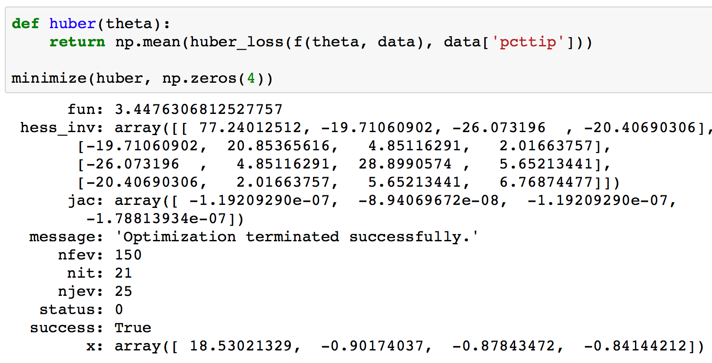
Define and Minimize the Loss

